Slide 1
SWE 312 Final Presentation Dhahran Health Clinic
Group 5
Hashim Al-Ghamdi
Haitham Al-Saeed
Salem Bamukhier
Salman Al-Ghamdi

Slide 2
Use Case Model

Slide 3
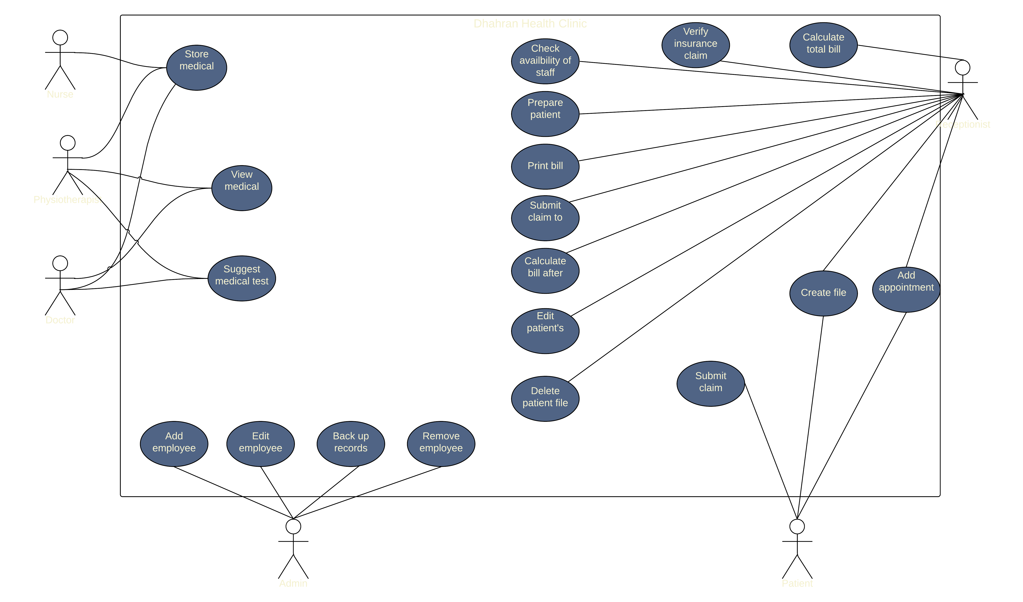
Use Case Diagram

Slide 4
Use Case Description
Back-up records | Name of use case
System admin | Actor(s):
Back-up all records in the databases. | Description of use case
1- Select the record(s) to be backed-up. 2- Select backup now. | Successful Completion Steps
None. | Alternative Steps
System admin is logged in to the system. | Pre-condition:
All records in the databases have been backed-up. | Post-Condition:
Availability of external backup drives. | Assumptions:
Create file | Name of use case
Receptionist Patient | Actor(s):
The receptionist gives the patient a form to fill, then the receptionist enters the records to the system or the user does it themselves in the system. | Description of use case
1- The receptionist enters the patient’s personal records as a form to the database. | Successful Completion Steps
1- The patient enters their name 2- Enter birthdate 3- Enter national ID 4- Enter contact info 5- Enter insurance (if any) 6- Enter password | Alternative Steps
Receptionist Logged in. Patient file does not exist. | Pre-condition:
The patient can make an appointment. The patient can request any type of medical tests. | Post-Condition:
None. | Assumptions:

Slide 5
Design Considerations

Slide 6

Logo Design
The logo was designed to stand out without using obvious symbols

Slide 7
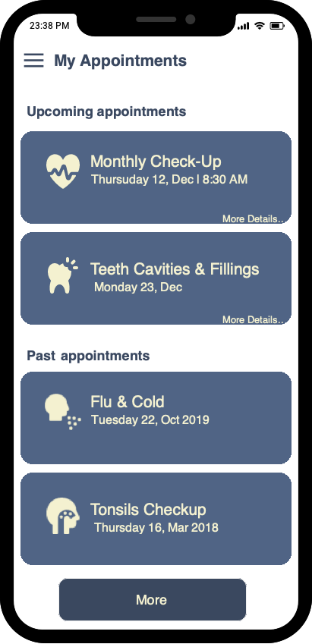
Familiarity
“By making the system look similar to other systems will make it easier to use.” (Jakob’s law)

Slide 8
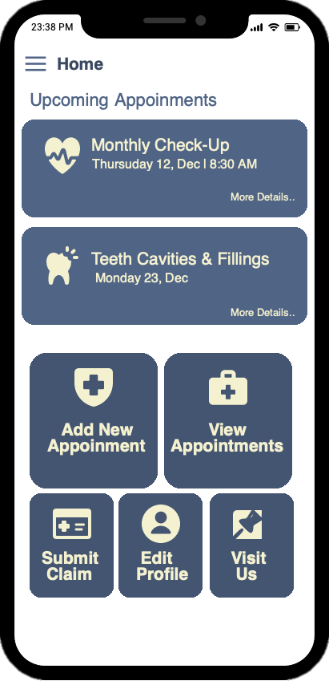
Visual Aids
By using icons that conveys the functions of the elements of the UI.

Slide 9
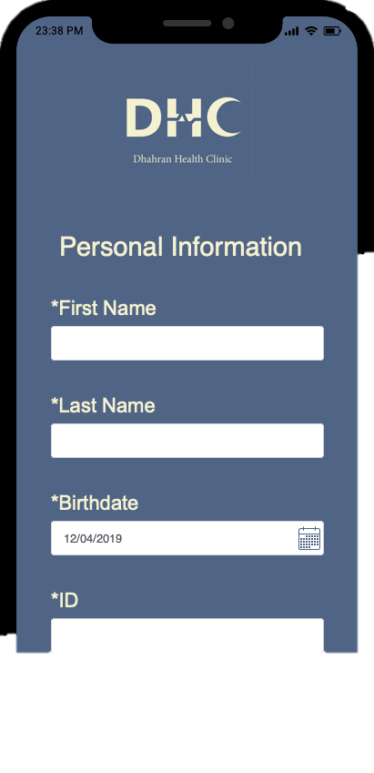
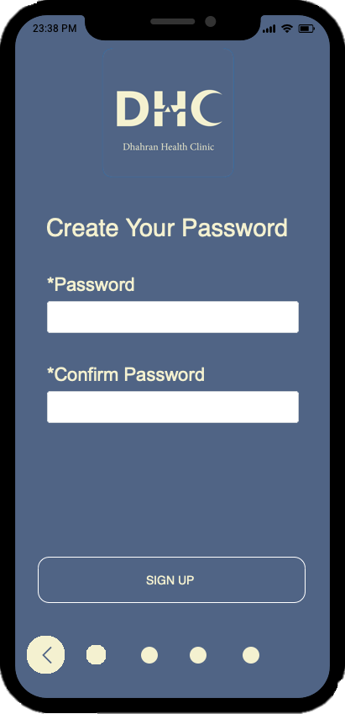
Simplicity
Splitting the complicated forms into smaller sections.

Slide 10
Sketch Prototype

Slide 11
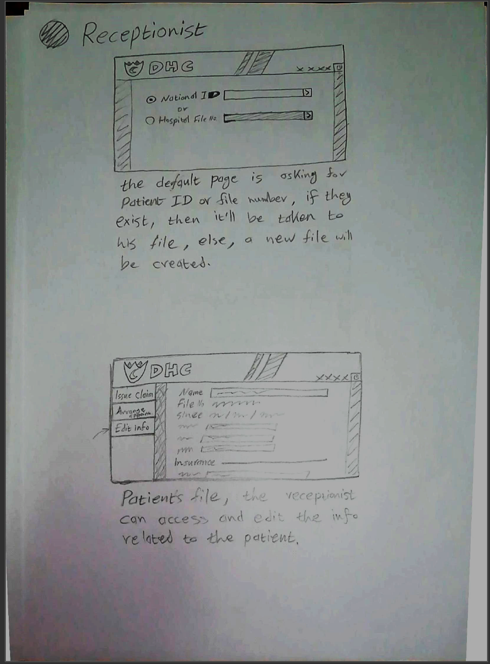
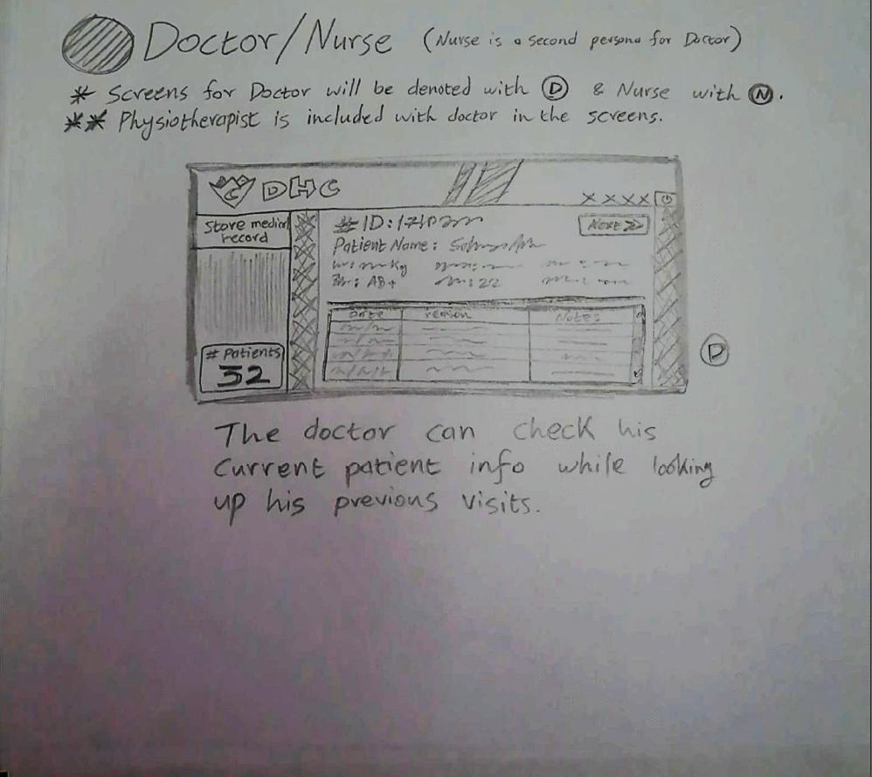
Receptionist
Doctor/Nurse

Slide 12
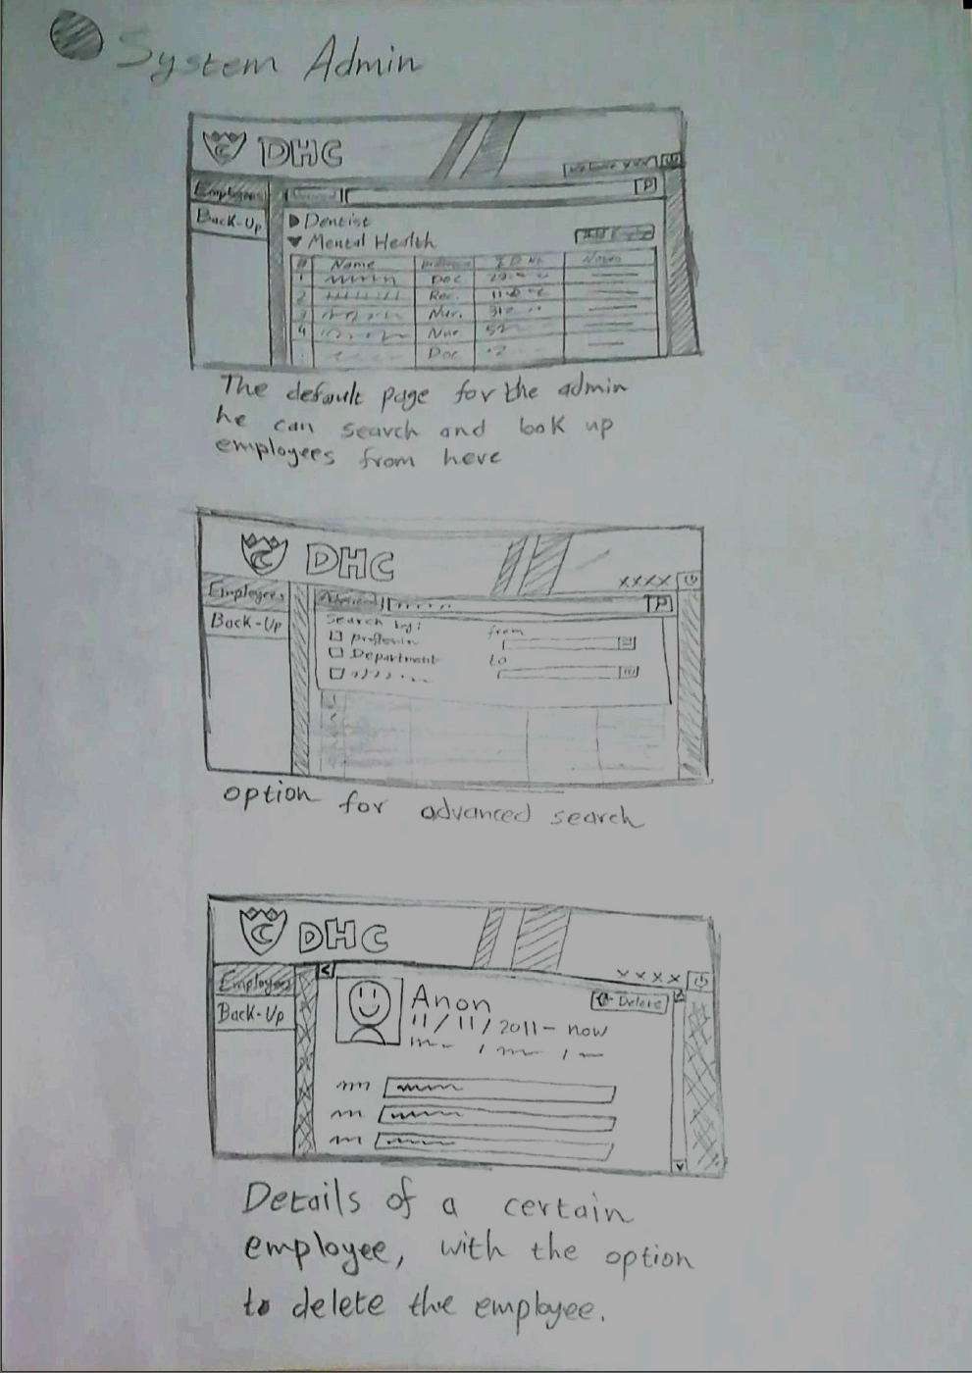
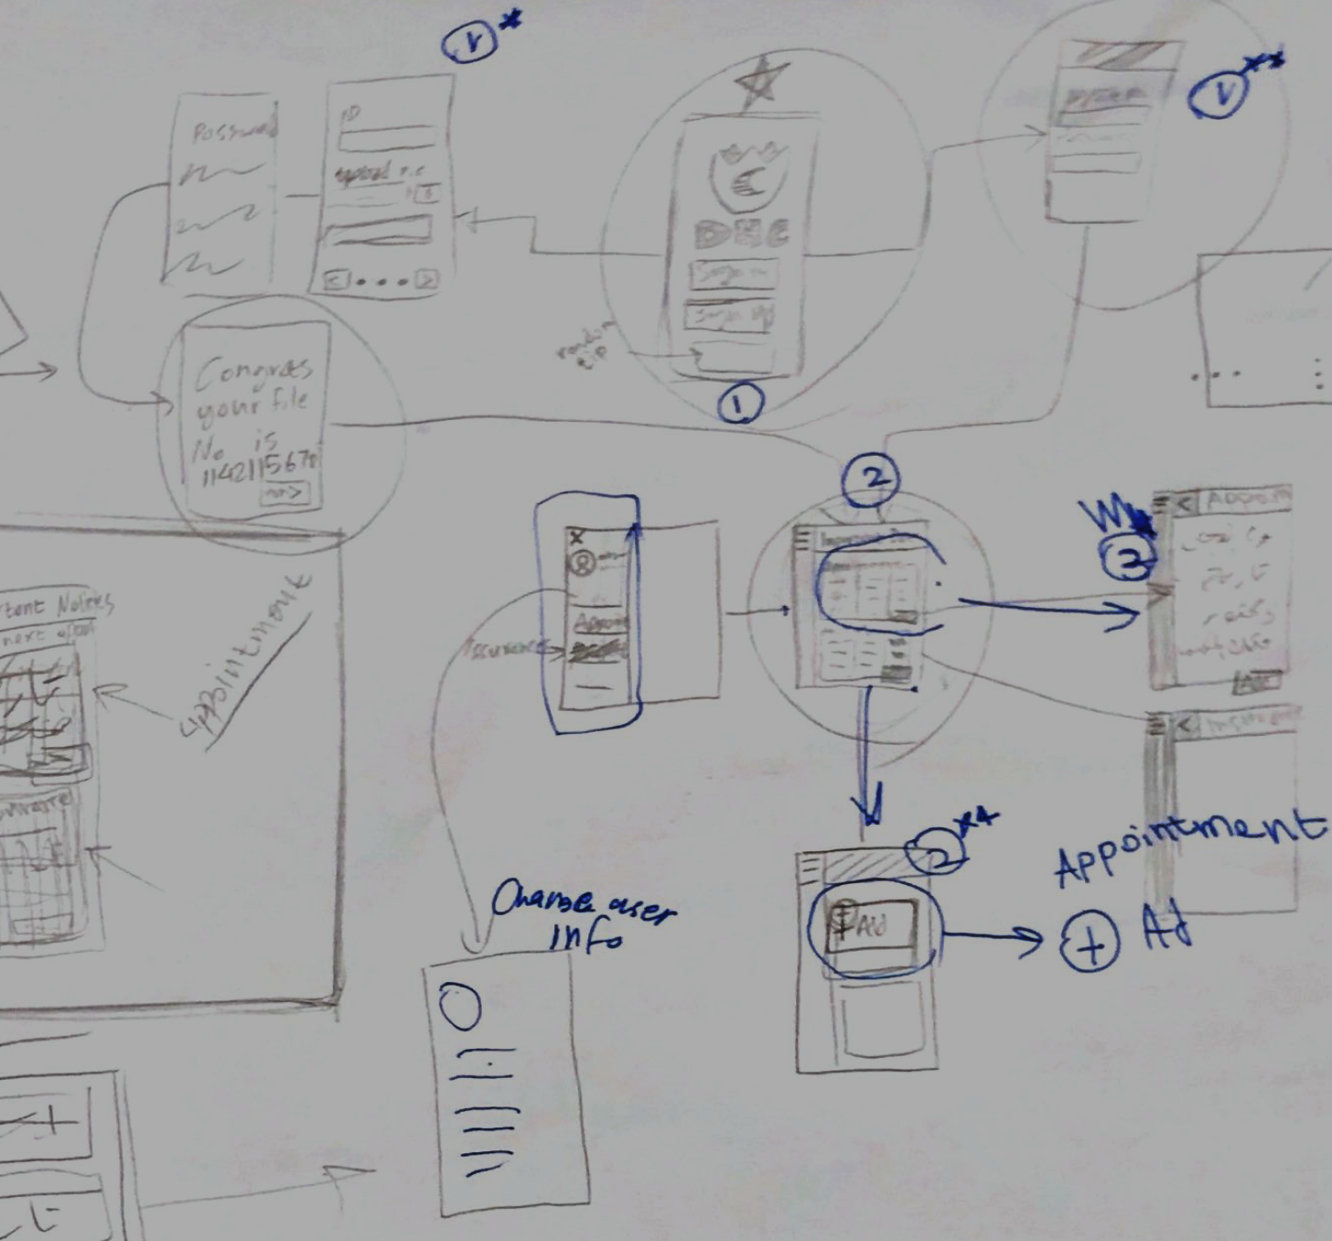
System Admin
Patient

Slide 13
Developed Prototype

Slide 14
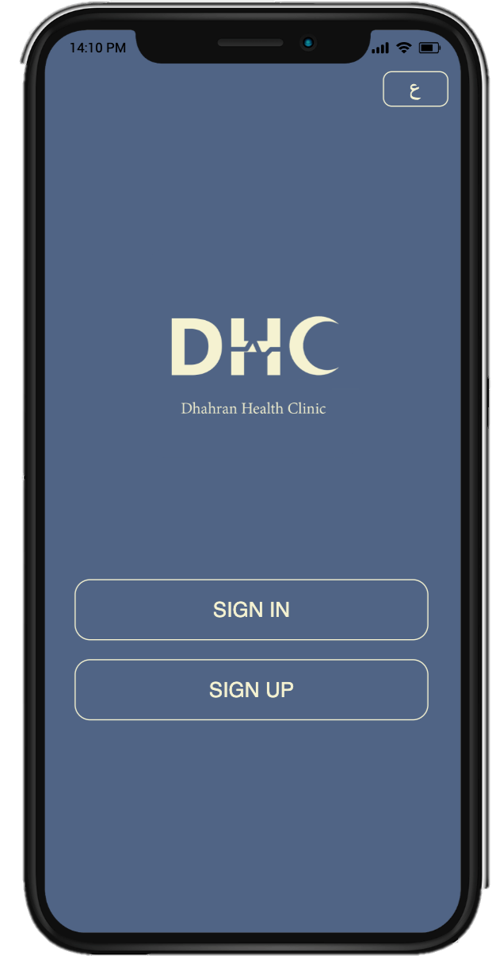

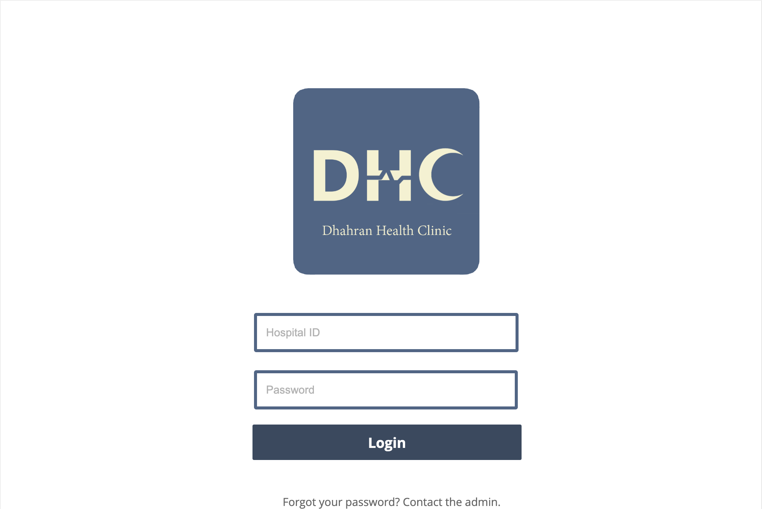

Slide 15
Evaluation Criteria
Mobile Criteria:
Structure
Use of Color
Buttons
Navigation
Consistency
Alignment
Typography
Readability
Desktop Criteria:
Structure
Use of Color
Readability
Page Layout
Rating scale: 1 = Very poor, 2 = Poor, 3 = Mediocre, 4 = Good, 5 = Excellent, 6 = Very Excellent

Slide 16
Evaluation Feedback & Response

Slide 17
Desktop feedback:
Structure
Is it easy to get back to Home page?
4 (There is no home page button, but the user can easily press back button until home page is reached.)
Page Layout
Are elements sized and arranged to fit within browser window?
4 (Overall, the size of the elements is appropriate, but it is very big if the user wanted to use it in smaller window)
Overall evaluation: 5 (Excellent)
Summary: The interface is user friendly. It is clear to the user how to do the required tasks. The only possible disadvantage in the design is that 50% of the page contains dark color, which may not be appropriate for some users.
Mobile feedback:
Use of Color
Are there a good color palette and a good color relationship? Does the color palette appeal to the target audience?
6 (The background is dark, and the fonts are light, so they make good combination)
Structure
Can you navigate readily from page to page?
5 (There is no navigation bar but there is maximum of two pages for any task)
Overall evaluation: 6 (Very Excellent)
Summary: The interface is user friendly. It is clear to the user how to do the required tasks, and everything is organized according to a specific sequence.

Slide 18
Evaluation Response
The feedback was generally positive so we did not feel a need to change anything.
As for the points mentioned previously this is our response to it:
No home button:
As the evaluators stated, we don’t have a home button but because the numbers of screens for each user is very small all they have to do is click back and they’re there.
Page layout:
The window should be responsive and adjustable to different screen sizes so it should not be a problem.
No navigation bar (on mobile):
A navigation bar for the mobile app is an excellent idea but we feel because there’s a burger menu in every screen and it takes you to wherever you want then this takes place of that.

Slide 19
Thank you for listening
Any questions? Issues? Concerns?

